Slide 1

Website Redesign for Inclusive Teaching
Sadhana Boddhula, Jessica Dang, Courtney Kowaluk

Slide 2
Introduction
WordPress
Goal
Key tasks
Software
Usability testing
Purpose
Enhance user experience
Website for Equity and Inclusion in teaching has issues
New design implementation
Integrating educational content
Website functionality
HTML/CSS
Javascript
Improve website functionality
Have website contain resources that are easily accessible

Slide 3

About
Started by Diversity, Equity, and Inclusion at Pitt to provide resources for educators
Providing varied learning approaches and tools tailored to individual needs, ensuring a conducive educational environment
Accessible resources, assistive technologies, and implementing reasonable accommodations to support academic success and engagement in learning

Slide 4

Project Significance
Addresses a critical need in education by promoting inclusive teaching practices and creating a welcoming environment for all learners.
Aims to improve user experience on the website by redesigning and updating it
Involves usability testing, new design implementation, and additional educational content integration

Slide 5
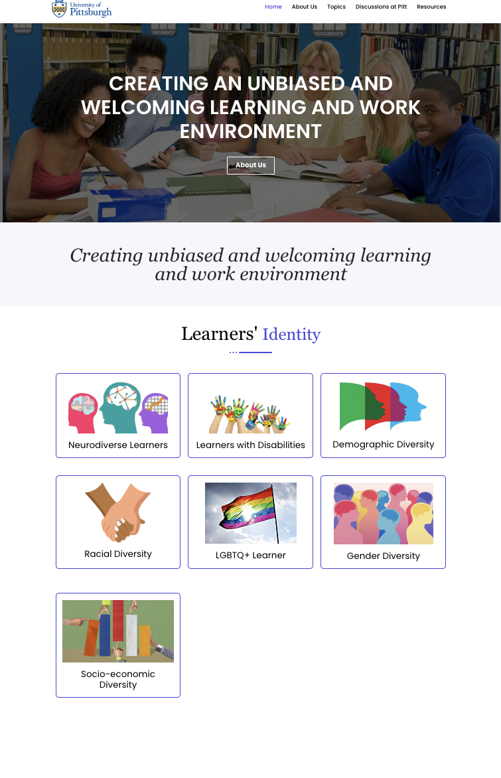
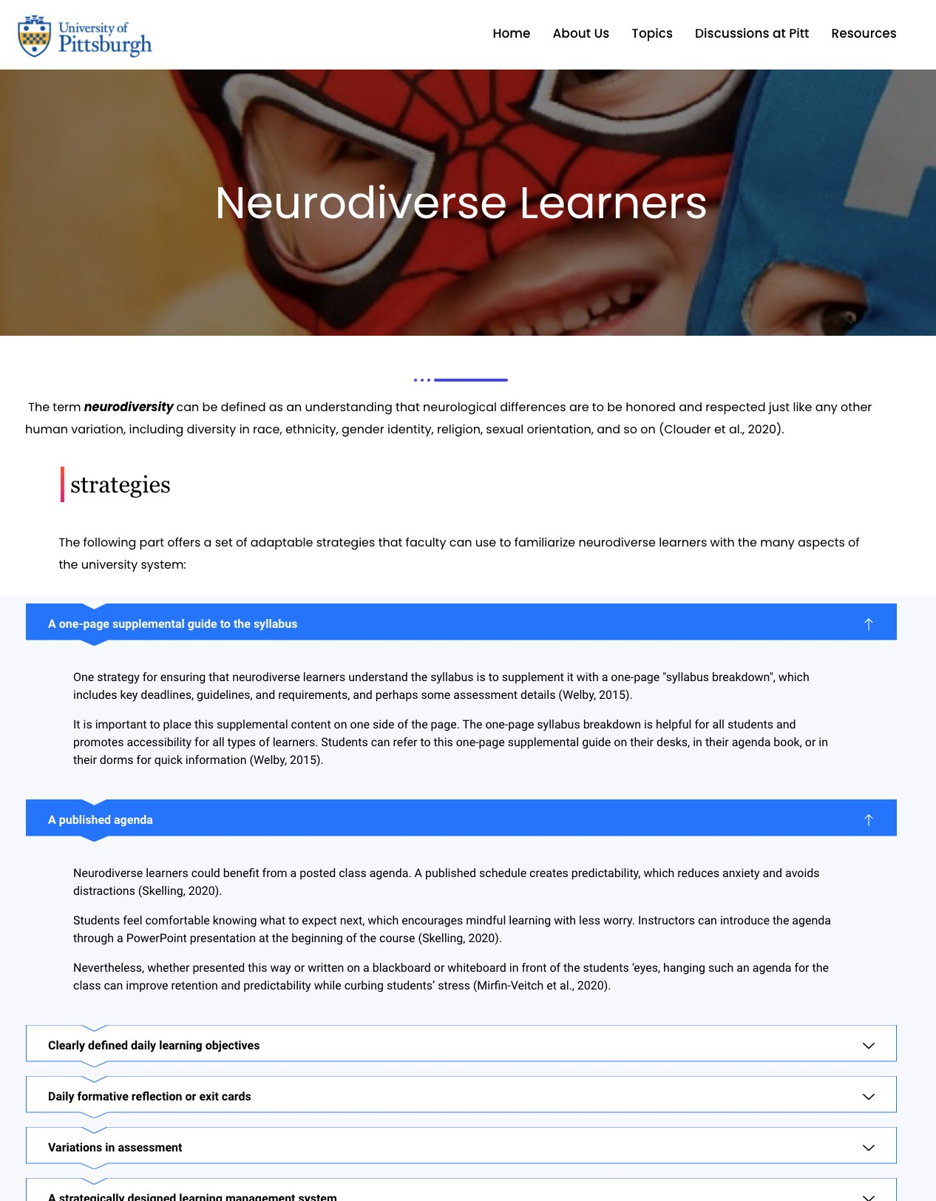
Current Website Analysis
Identified key areas for improvement in website design
Assessed the functionality of the website
Evaluated website content

Slide 6
Current Website Issues
8 Broken Links
Page not found errors
Links lead to different sites than intended
Pages display
Pages are not uniform with each other
Content is not centered
Templates for pages vary
Areas of site such as 'About Us' are in very large text, making it unappealing to the user
Visual Appeal
'Wish to know more?' text is very large
Intro page text does not represent the intended purpose of the site

Slide 7
User Stories
Created user stories prior to prototyping and user testing to help assess ideal website design and goals
User story 1:
A neurodiverse student struggling with sensory overload needs adjustable display settings and clear navigation for improved focus and learning.
User story 2:
A learner with a visual impairment requires screen reader compatibility, high color contrast, and alternative text descriptions for images to access content effectively.
User story 3:
An LGBTQ+ individual seeks inclusive language, diverse representation in imagery, and easily accessible support resources for a welcoming online learning environment.

Slide 8
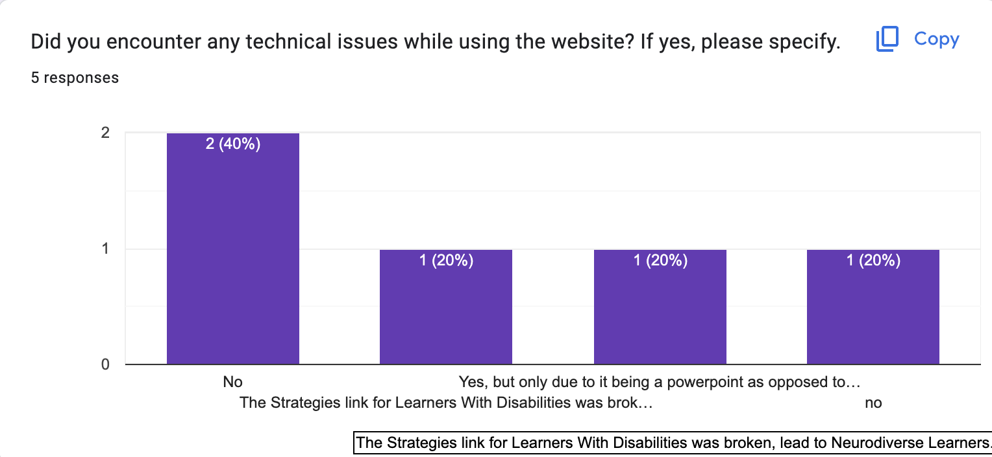
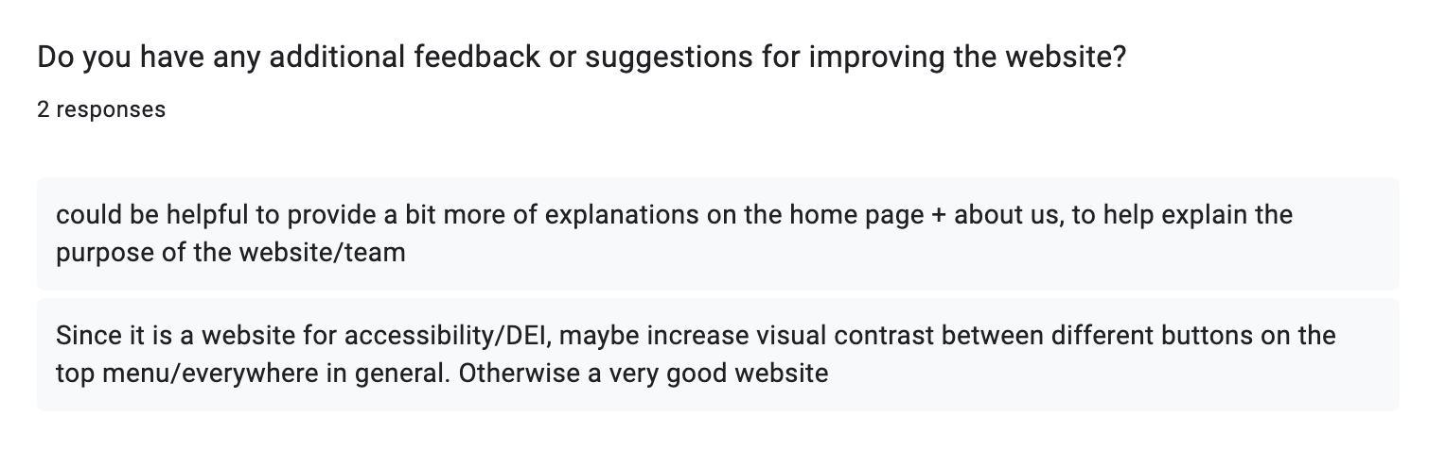
Usability Testing Methodology
Create a functional prototype over the scope of the tasks assigned to users
Conduct a thinkaloud with each user, recording session
Provide users with a survey after testing session
Analyze user tests, identifying critical events and user preferences

Slide 9
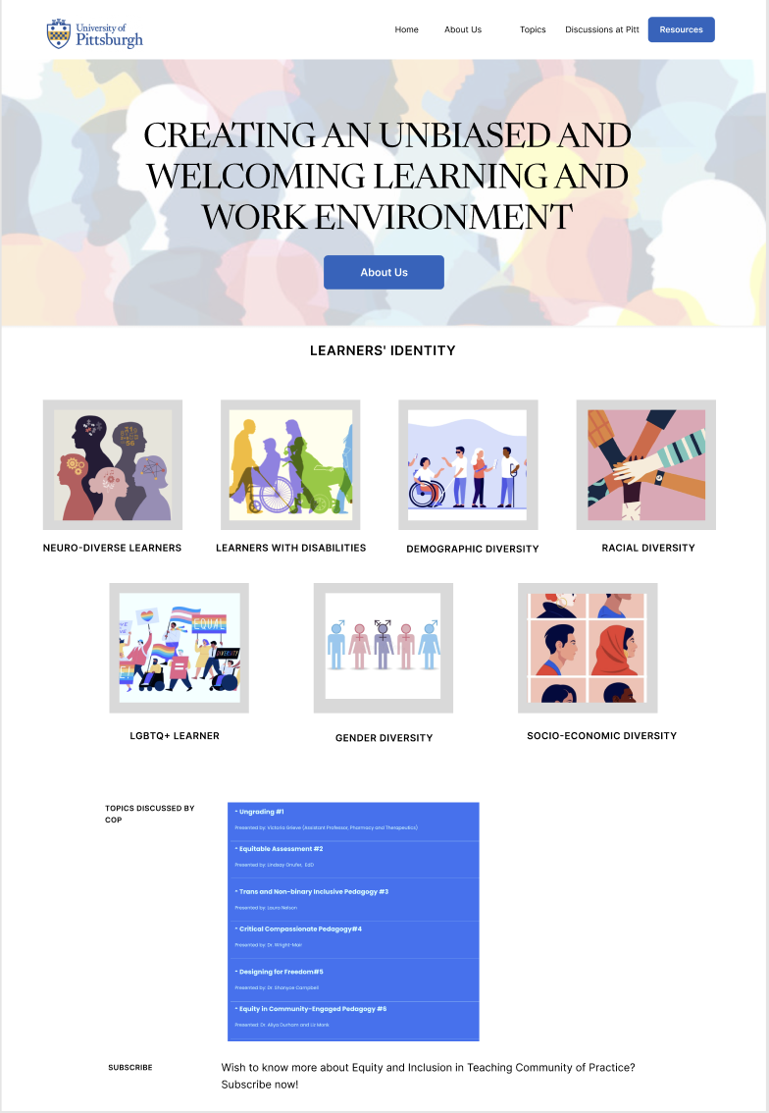
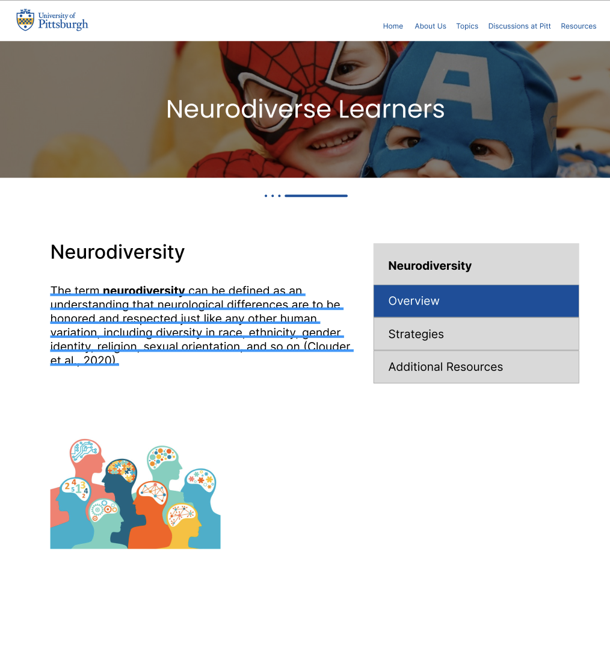
Design Concept
Create a more visually-appealing website with:
softer-colored graphics
more readable text
updated navigation panes
better layout
Improve page organization and naming to be more intuitive to users (ex: resources)

Slide 10
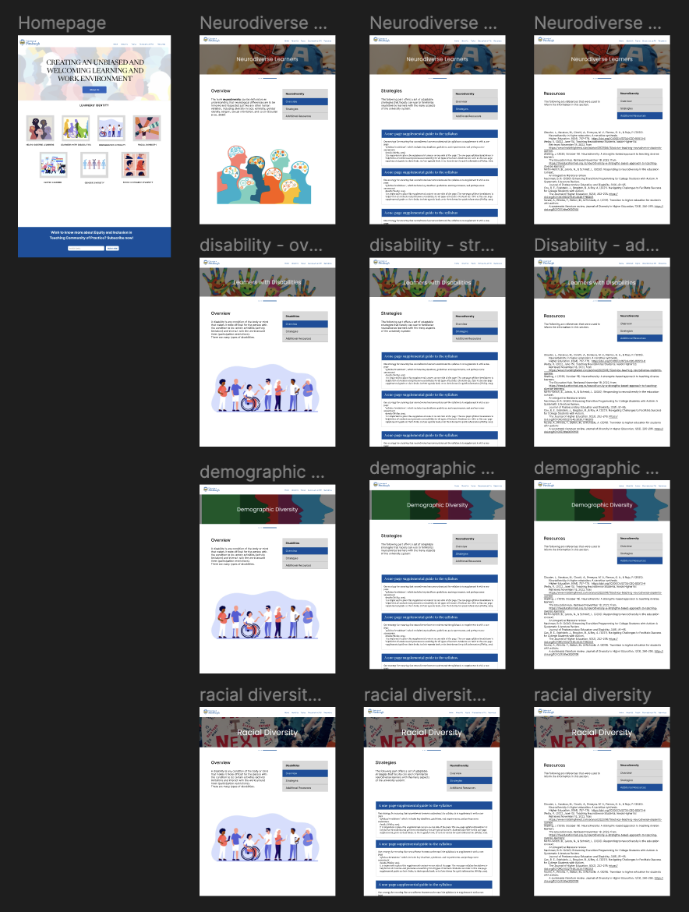
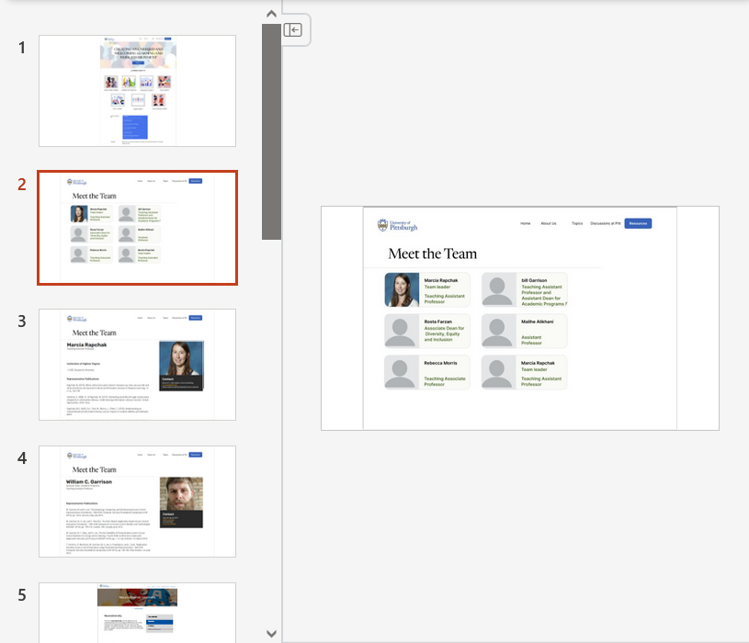
Prototype Development
Functional prototype made in Figma
Functional prototype made in PowerPoint

Slide 11
User Testing Analysis
Users mentioned the title on the Homepage does not signify the site's purpose
Users had difficulty navigating to pages because of a Page Not Found error
Users mentioned the stock photos on some of the pages do not match the content
Users expected the Resources page to have tangible resources, rather than a works cited

Slide 12
Issues
Specifications from sponsor were vague, unsure of ideal changes to propose
Website is hosted on WordPress, provides technical challenges
Sponsors proposed changing website to a Pitt-hosted website a few weeks in
Sponsors no longer want website to be Pitt-hosted
Finding users for testing and scheduling within timeframe has been challenging
WordPress tiers have limitations on custom code & CSS
Budgeting issues – not sure if website can be upgraded to a higher tier

Slide 13
Timeline of Progress
Meet with users for testing, conduct survey, analyze results
Make initial changes simultaneously
Initial Meeting
Meet with sponsor to determine expectations
First Assessment
Find issues with existing website, propose changes to sponsor
Prototyping
Make prototypes of changes, get approved with sponsor
User Testing Treparation
Finalize methodology for user testing, make prototypes and materials for testing, contact users
User Testing
Meet with users for testing, record sessions, conduct survey, begin result analysis
Make initial changes simultaneously
Make approved prototype of changes, get approved with sponsor
Meet with sponsor to determine expectations
Find issues with existing website, propose changes to sponsor
Finalize methodology for user testing, make prototypes and materials for testing, contact users

Slide 14
Future Steps
Continue to analyze usability testing to identify critical issues and potential design issues
Implement design and navigation changes to website
Remove unwanted and unused features from website
Integrate additional features such as calendars and viewable documents
Upload and build pages for additional content for website
Conduct testing for bugs within the website and analyze improved performance

Slide 15

Questions?

